Slide 1
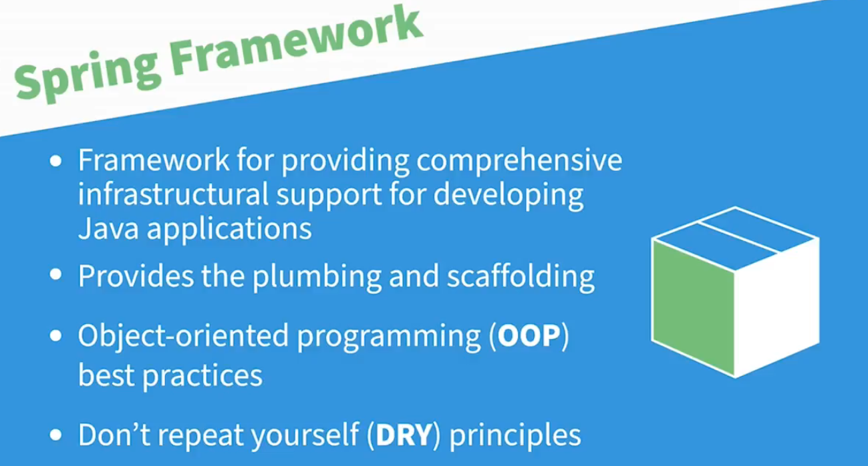

Slide 2


Slide 3
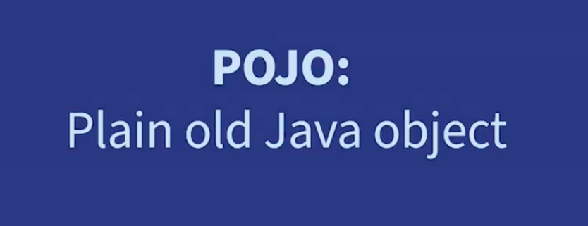

Slide 4


Slide 5


Slide 6
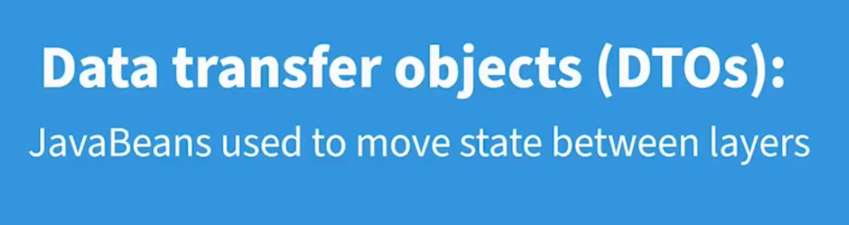

Slide 7
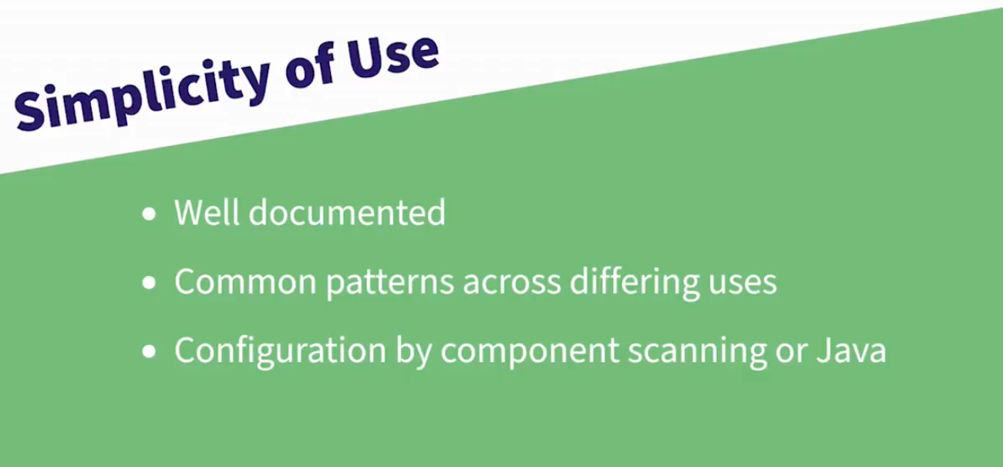

Slide 8
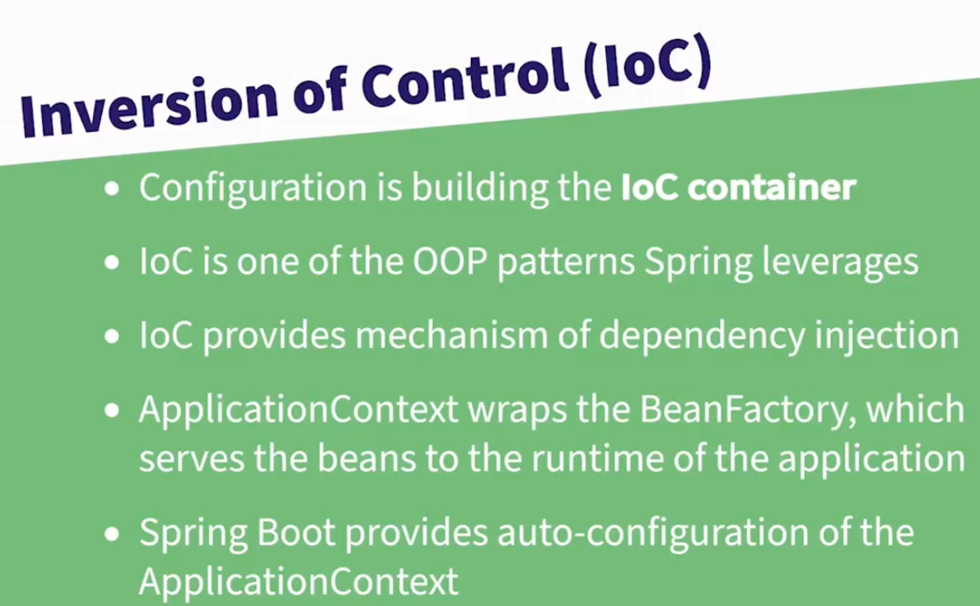

Slide 9


Slide 10
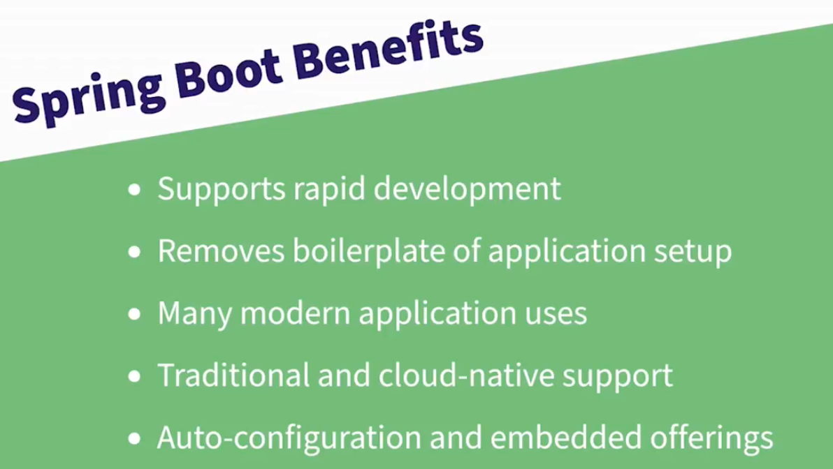

Slide 11
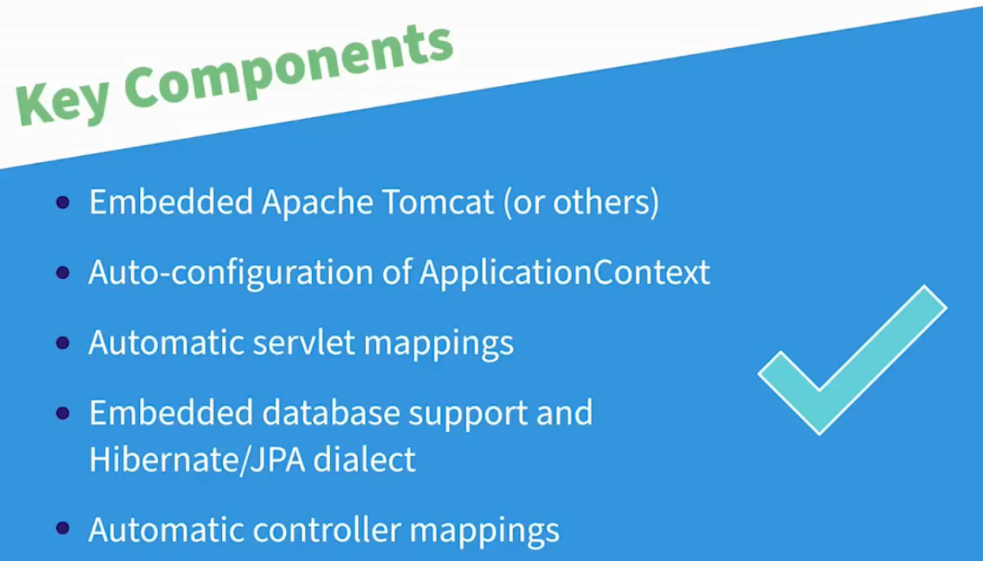

Slide 12


Slide 13
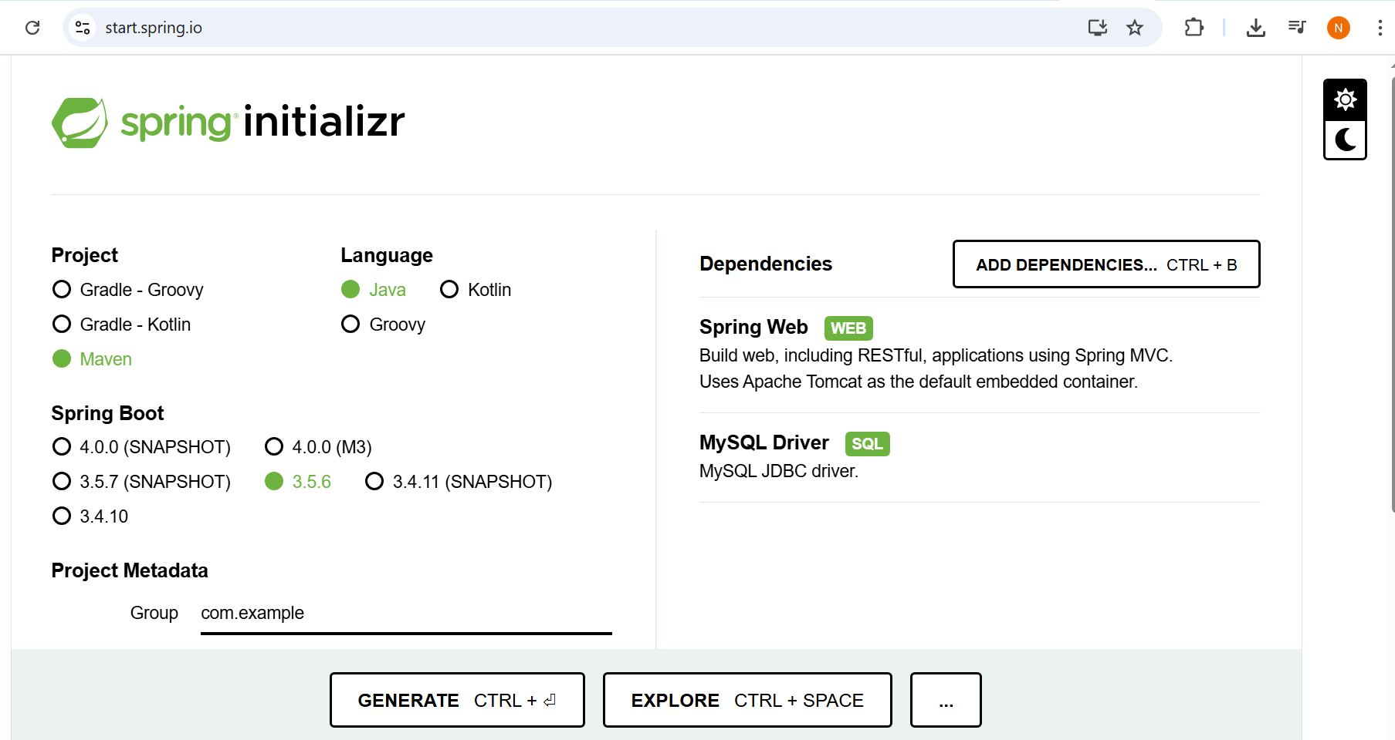

Slide 14


Slide 15
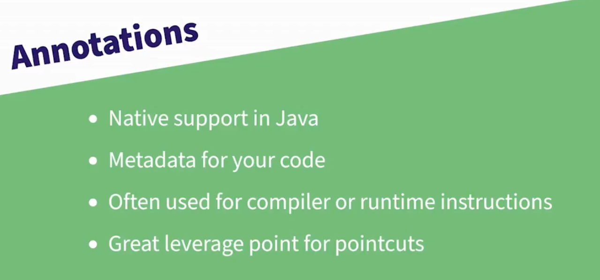

Slide 16
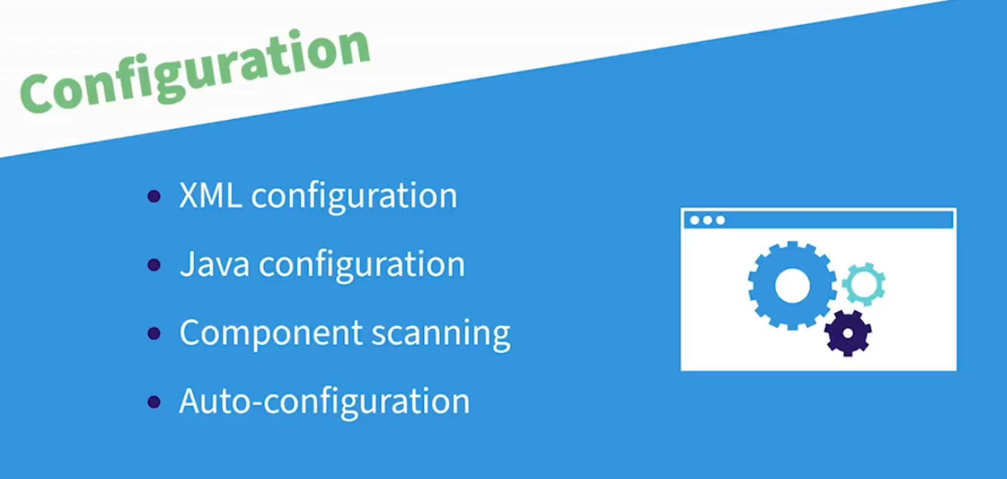

Slide 17
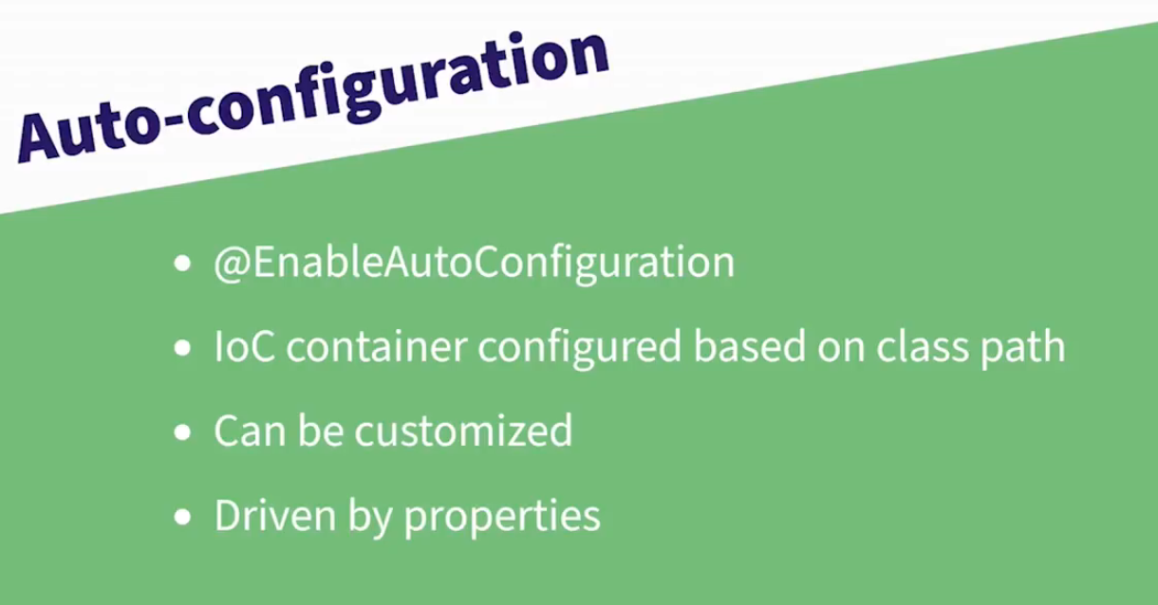

Slide 18
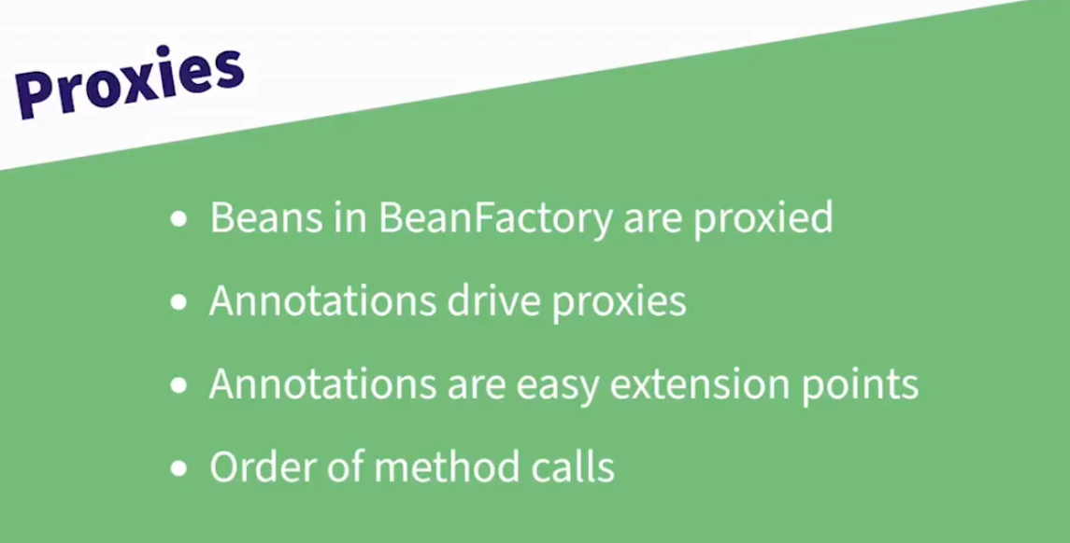

Slide 19


Slide 20
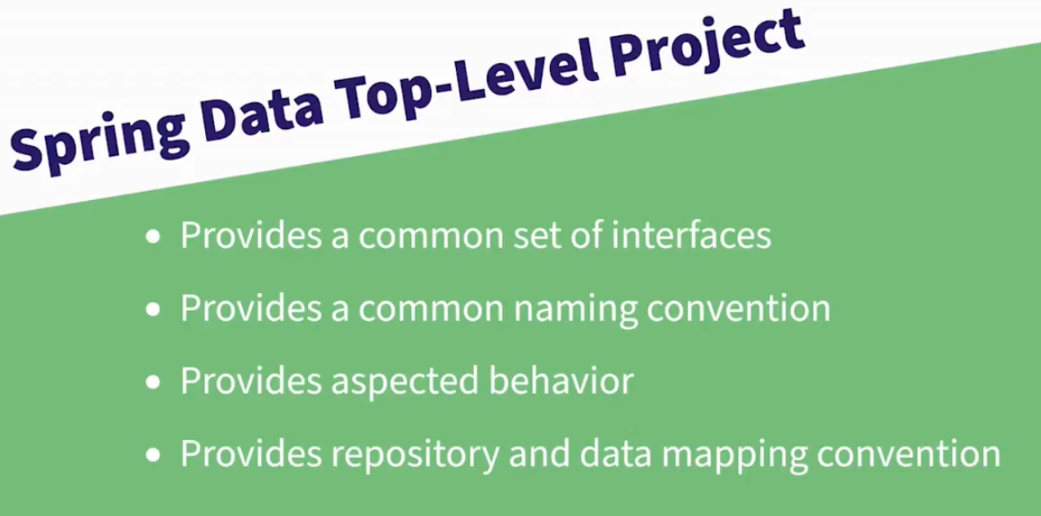

Slide 21
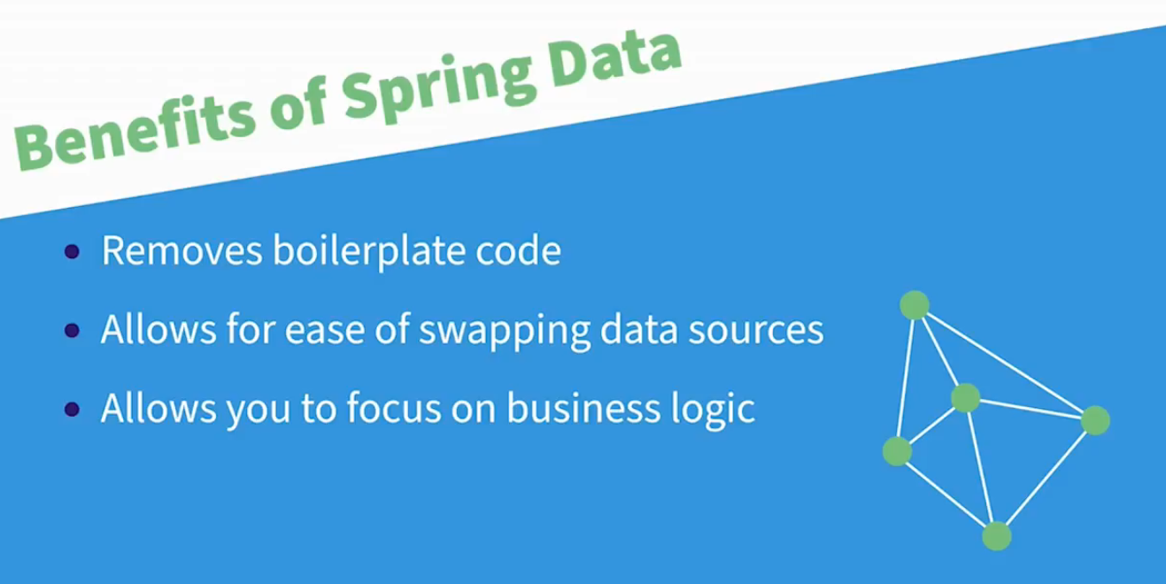

Slide 22
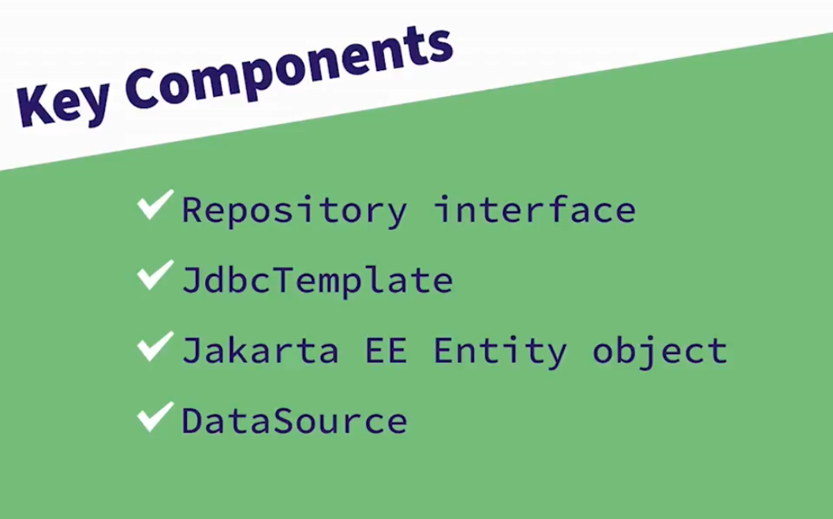

Slide 23
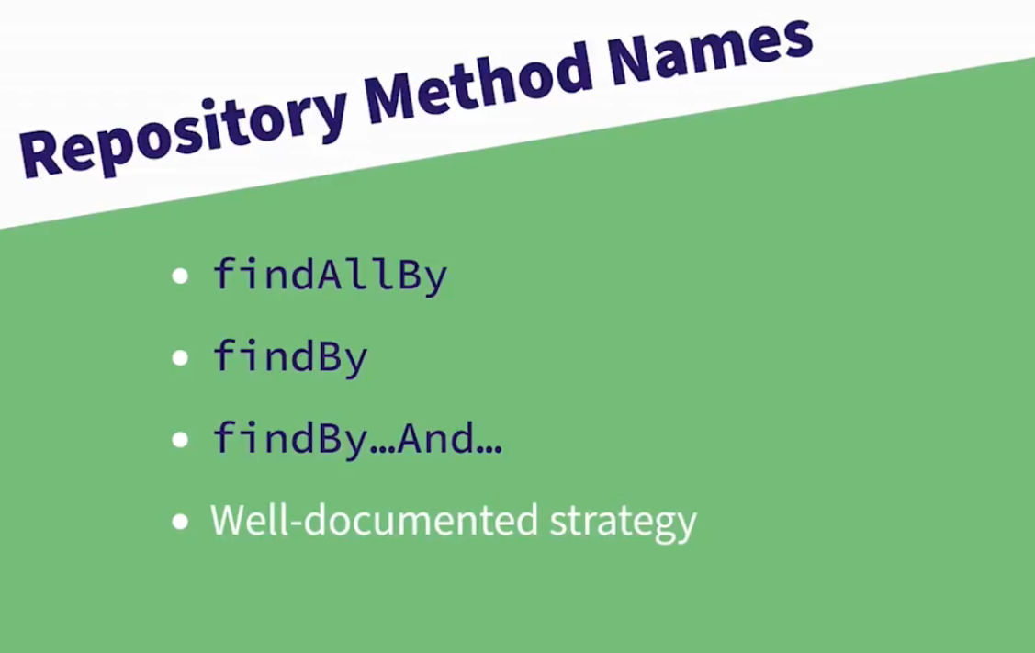

Slide 24
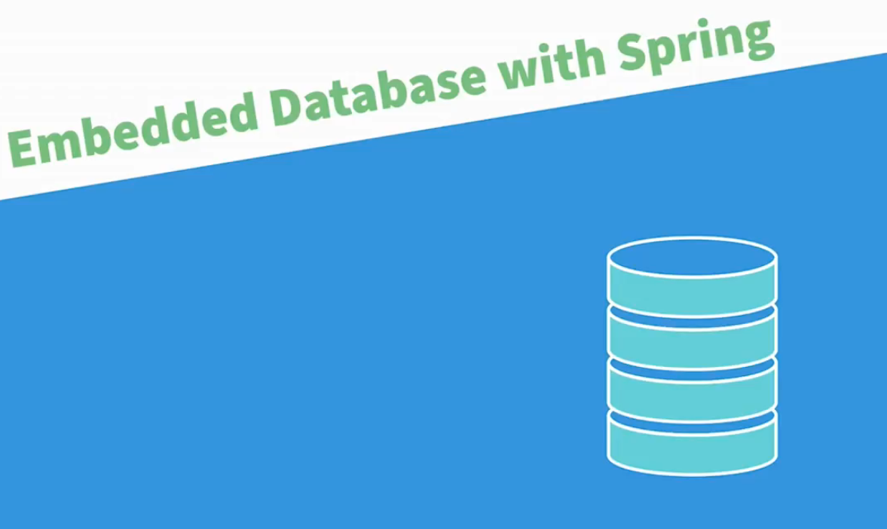

Slide 25
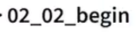

Slide 26


Slide 27
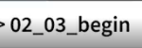
Notes:
C:\AWS-DevOPS\VP\All Courses\Microservices - Cloud Native\Demos\Ex_Files_Learning_Spring6_with_SpringBoot3\Exercise Files\02_03_end

Slide 28


Slide 29
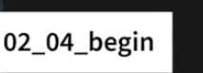
Notes:
C:\AWS-DevOPS\VP\All Courses\Microservices - Cloud Native\Demos\Ex_Files_Learning_Spring6_with_SpringBoot3\Exercise Files\02_04_end

Slide 30
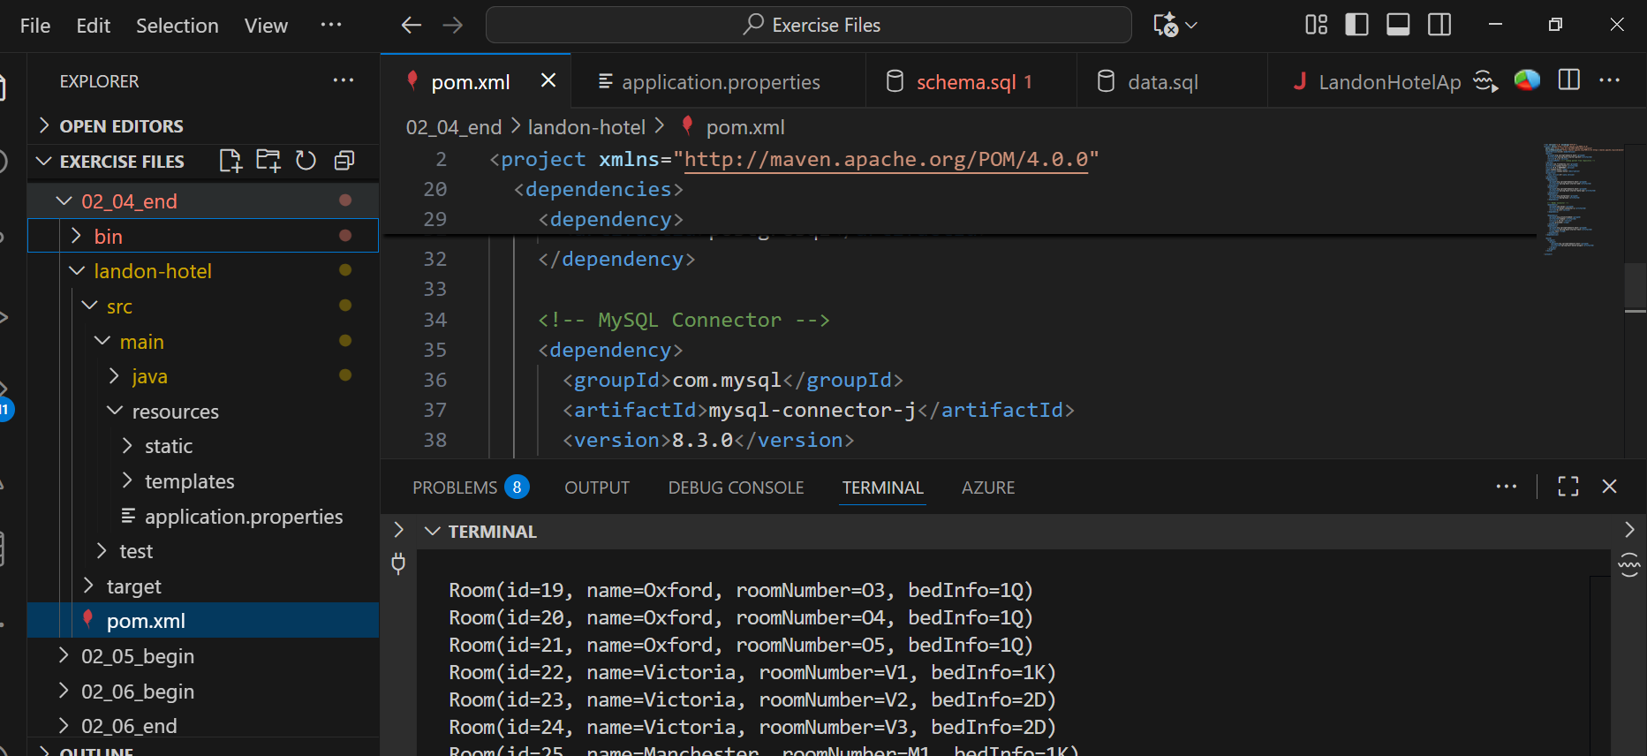
Notes:
Mysql example: C:\AWS-DevOPS\VP\All Courses\Microservices - Cloud Native\Demos\Ex_Files_Learning_Spring6_with_SpringBoot3\Exercise Files\02_04_end\landon-hotel

Slide 31
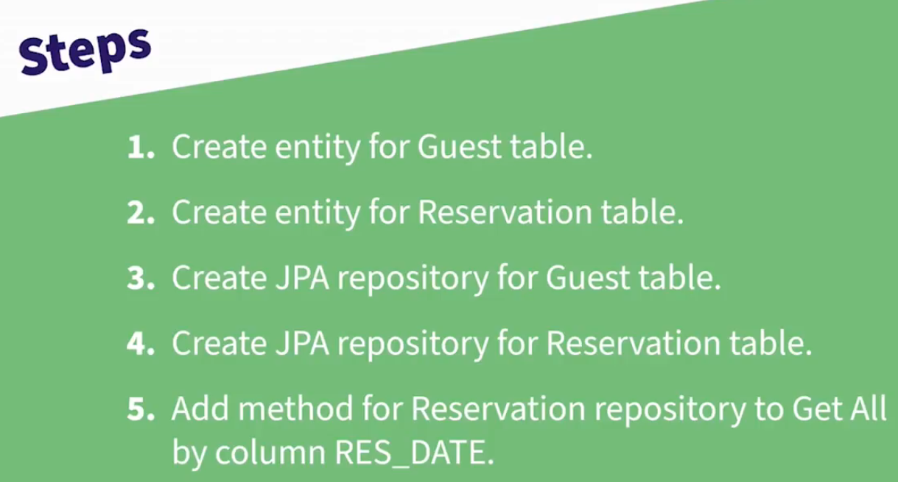
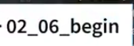

Slide 32


Slide 33
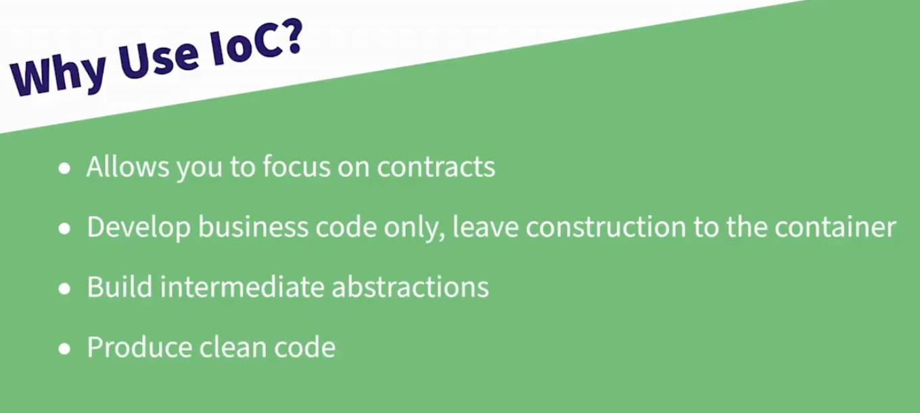

Slide 34
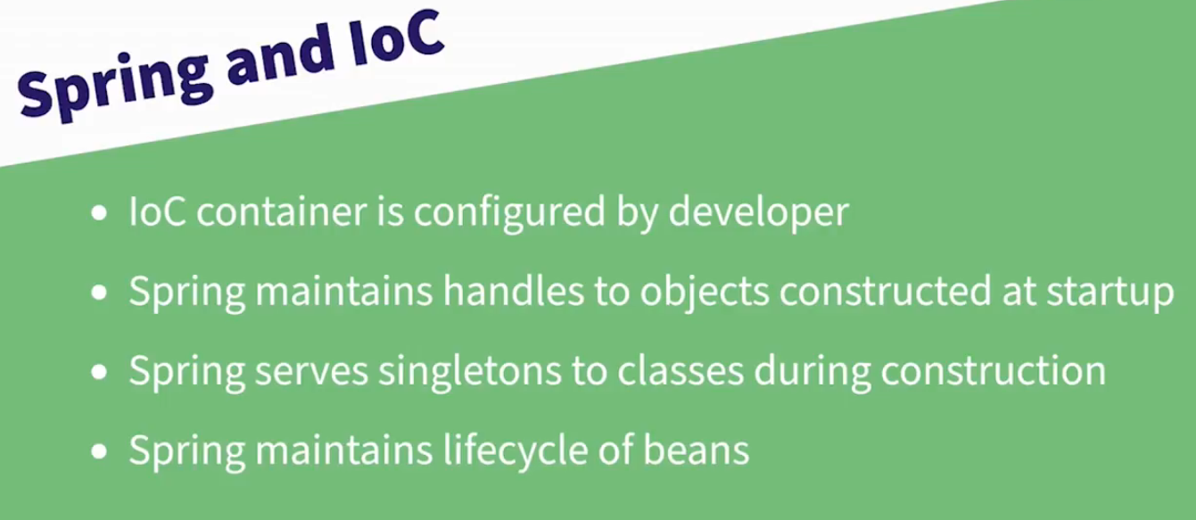

Slide 35
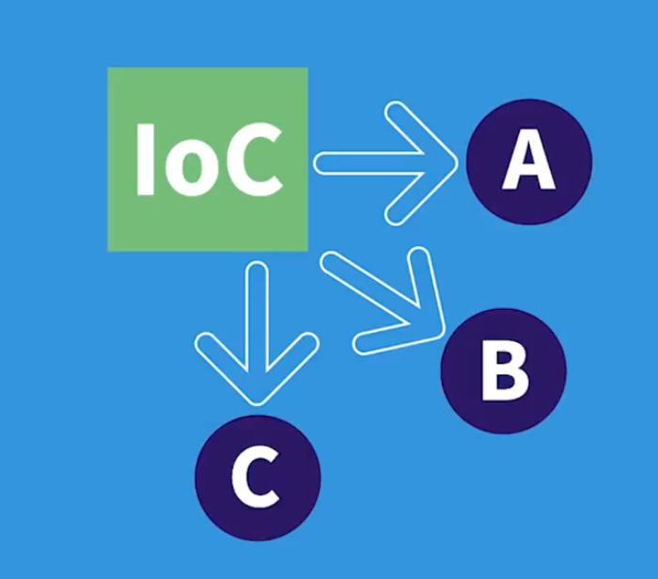

Slide 36


Slide 37
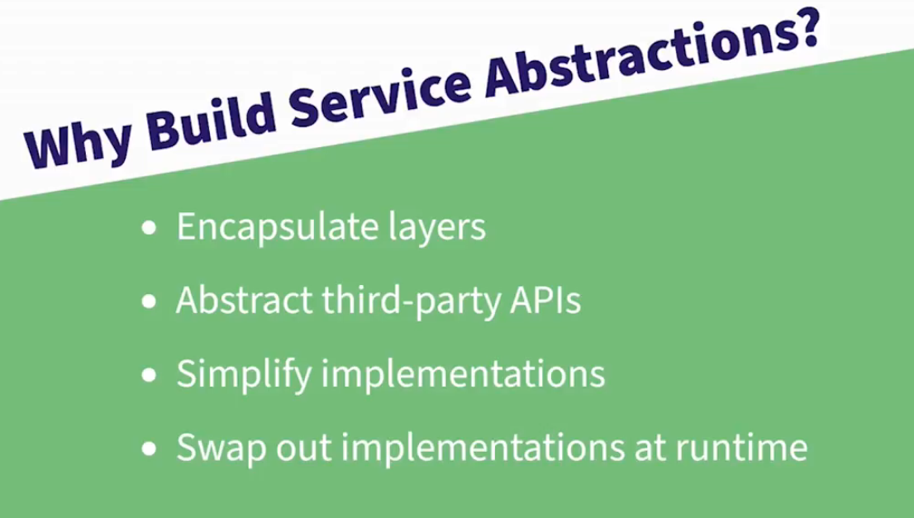

Slide 38
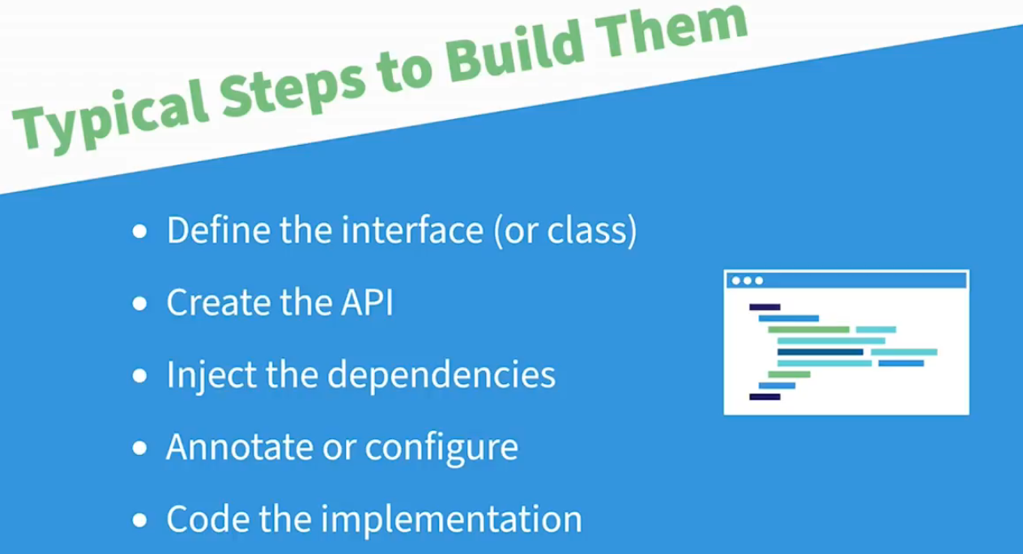

Slide 39


Slide 40
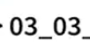
Notes:
C:\AWS-DevOPS\VP\All Courses\Microservices - Cloud Native\Demos\Ex_Files_Learning_Spring6_with_SpringBoing6_with_SpringBoot3\Exercise Files\03_03_end\landon-hotel

Slide 41


Slide 42
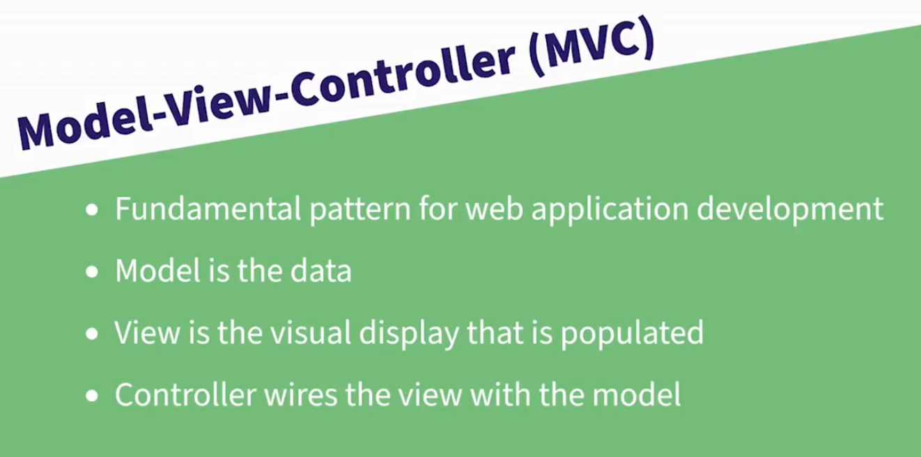

Slide 43
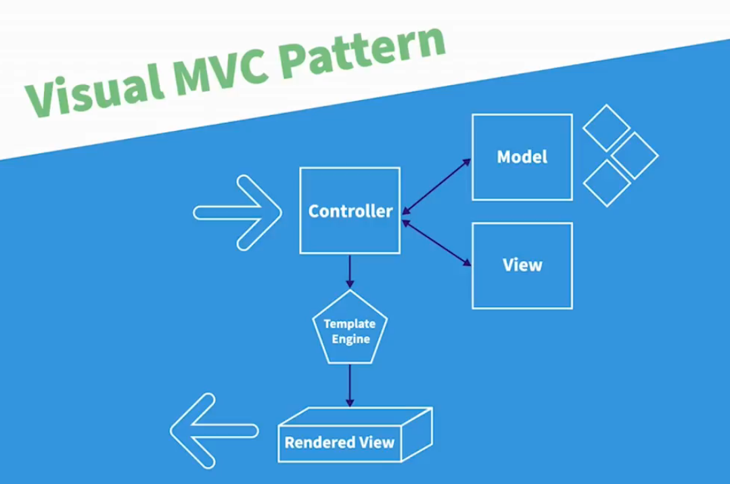

Slide 44
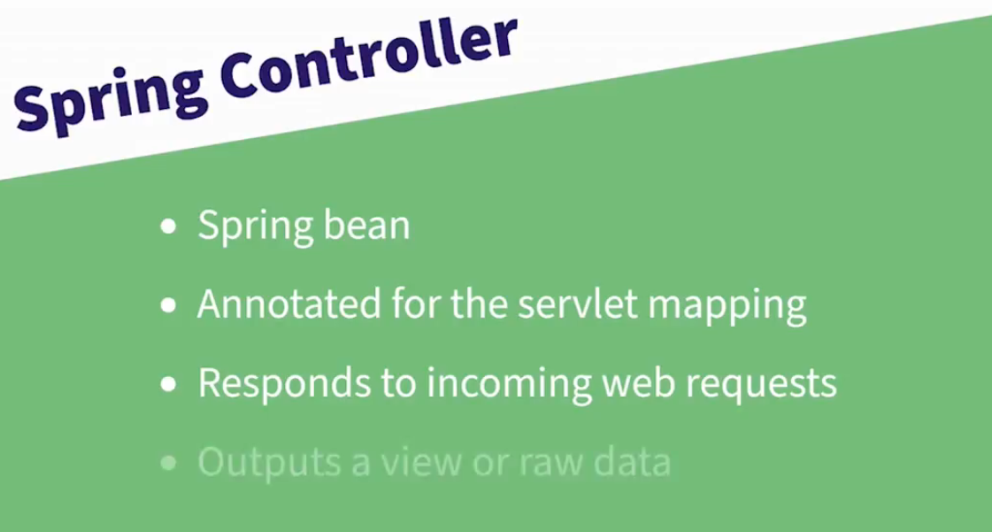

Slide 45
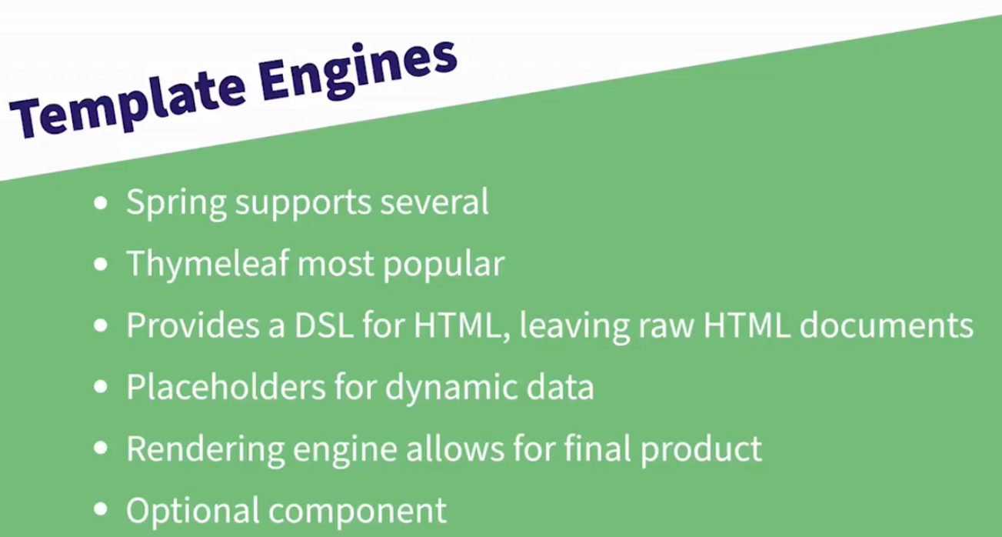

Slide 46


Slide 47
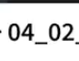
Notes:
C:\AWS-DevOPS\VP\All Courses\Microservices - Cloud Native\Demos\Ex_Files_Learning_Spring6_with_SpringBoot3\Exercise Files\04_02_end\landon-hotel

Slide 48


Slide 49
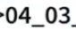
Notes:
C:\AWS-DevOPS\VP\All Courses\Microservices - Cloud Native\Demos\Ex_Files_Learning_Spring6_with_SpringBoot3\Exercise Files\04_03_end\landon-hotel

Slide 50
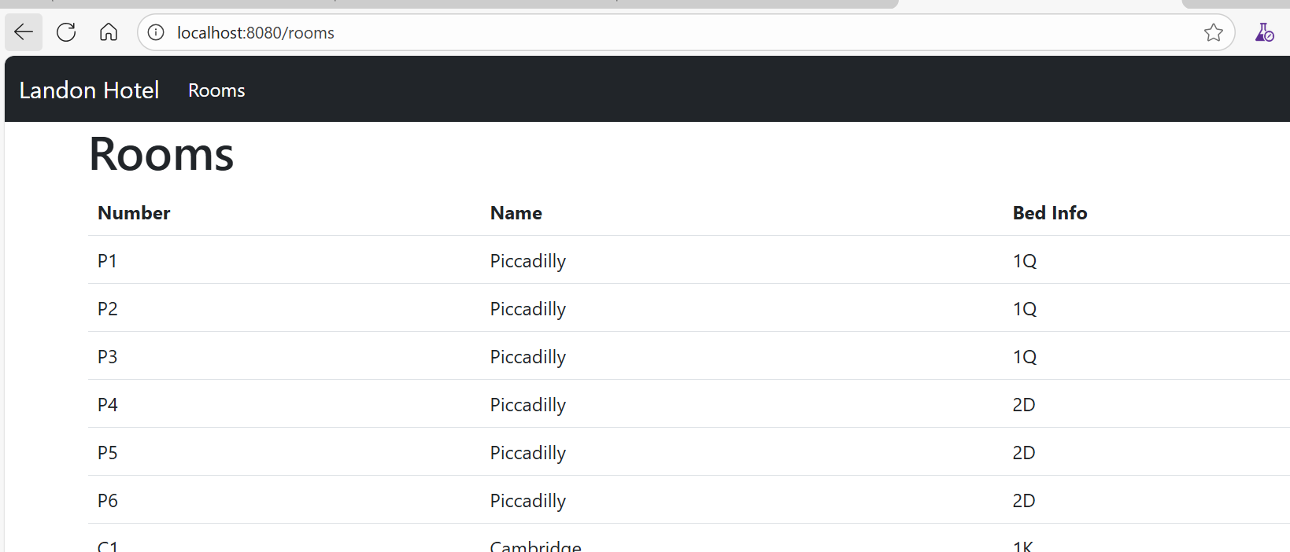

Slide 51
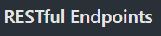


Slide 52
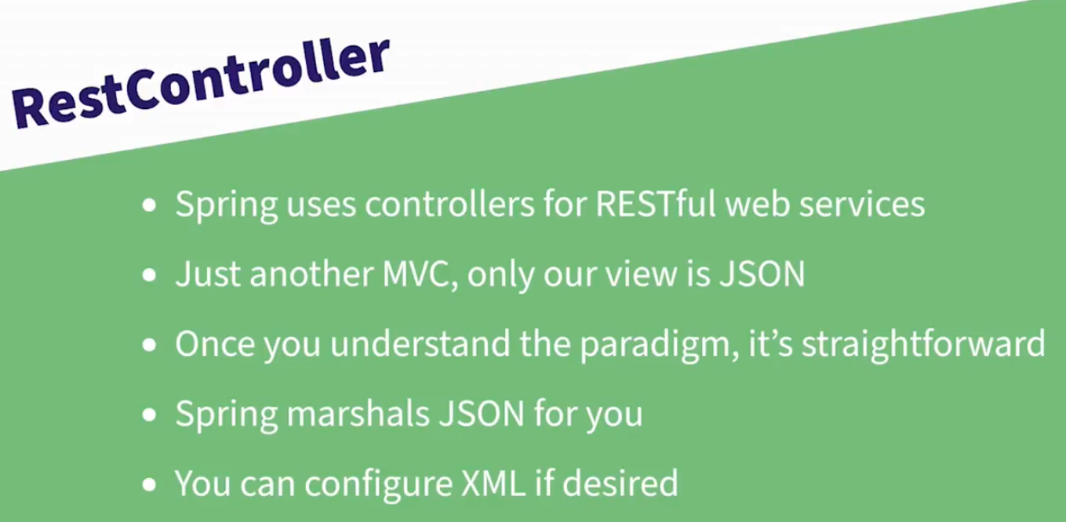

Slide 53


Slide 54
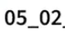
Notes:
C:\AWS-DevOPS\VP\All Courses\Microservices - Cloud Native\Demos\Ex_Files_Learning_Spring6_with_SpringBoot3\Exercise Files\05_02_end\landon-hotel

Slide 55
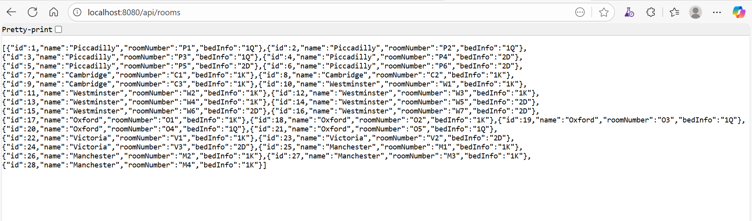

Slide 56
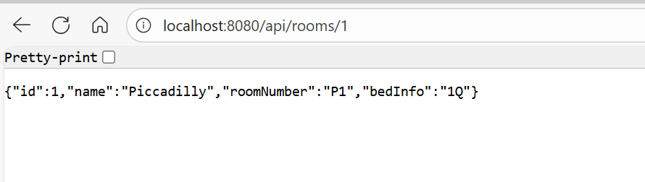

Slide 57


Slide 58
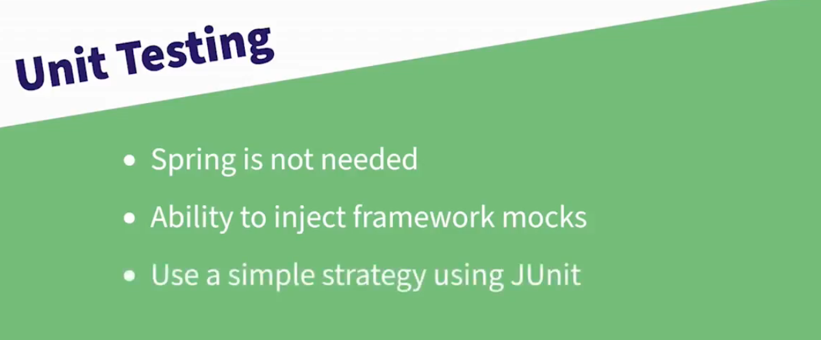

Slide 59
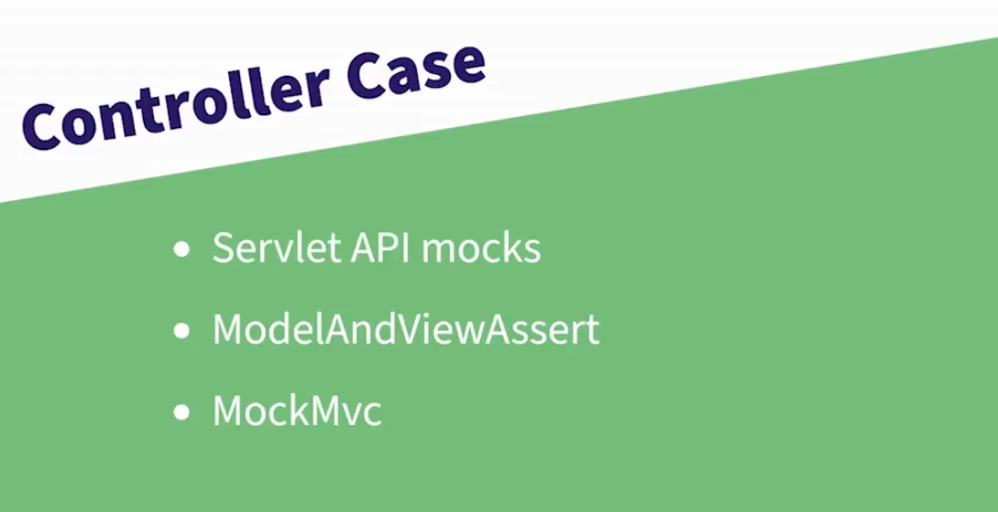

Slide 60
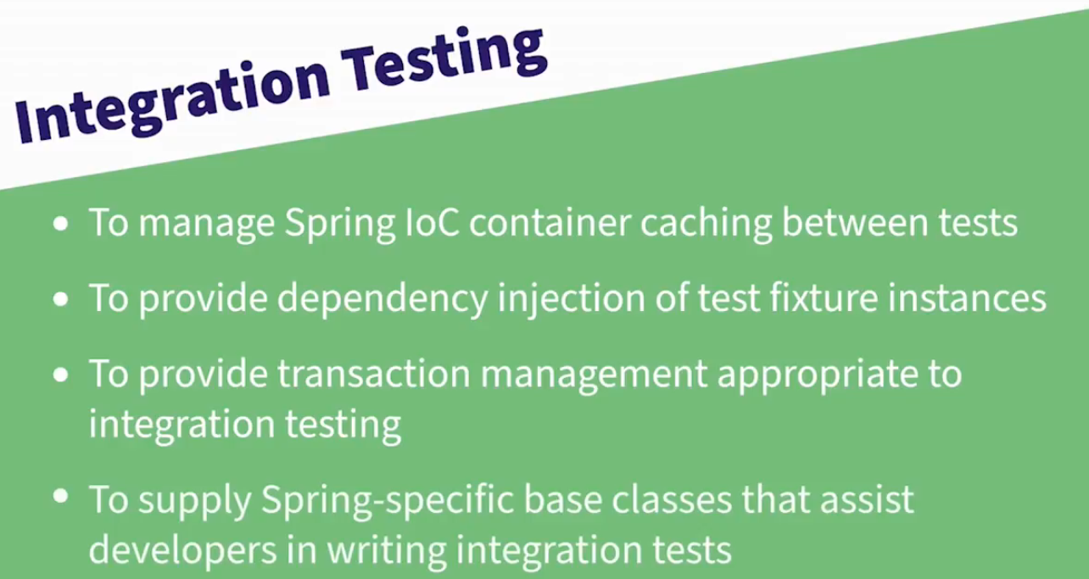

Slide 61
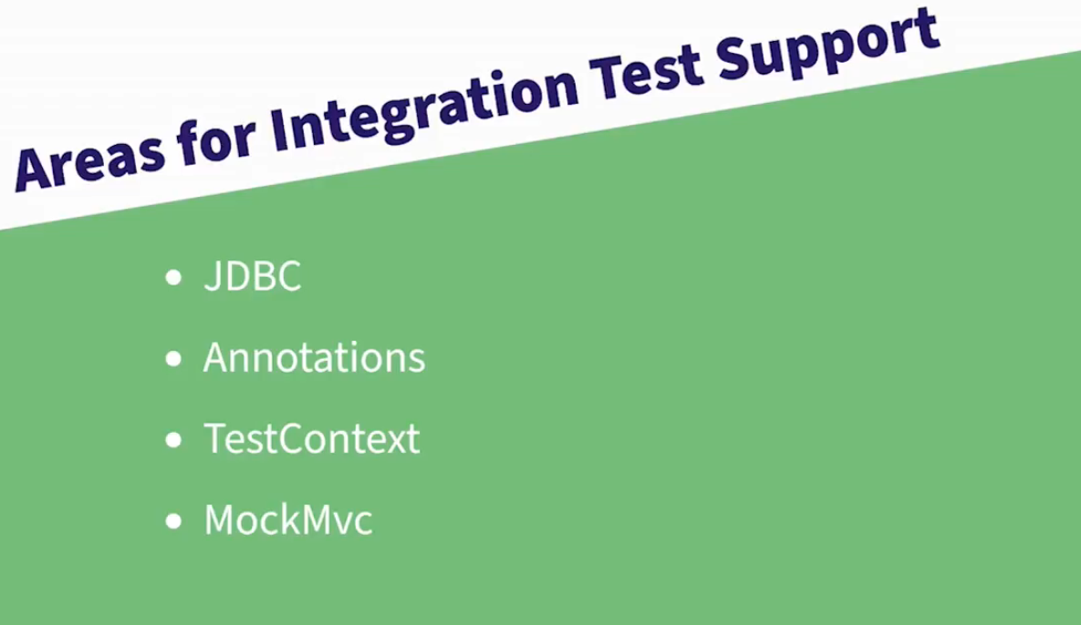

Slide 63


Slide 64
